Slide 1
Tom Farrer Capstone
MVVM with WPF
4x4 Tic Tac Toe
12/12/2019

Slide 2
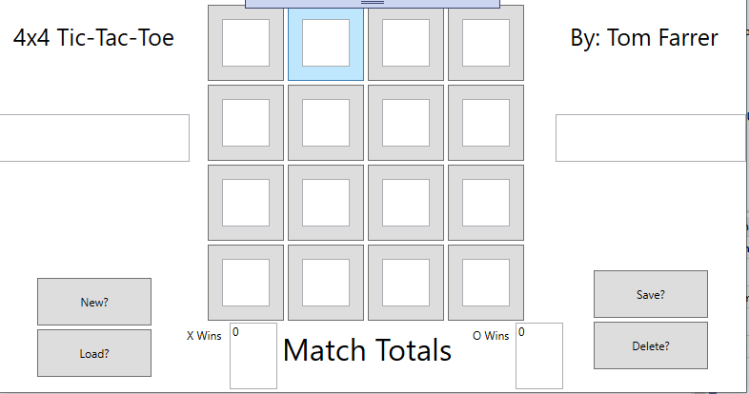
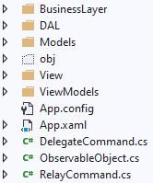
The Game Board & Architecture

Slide 3
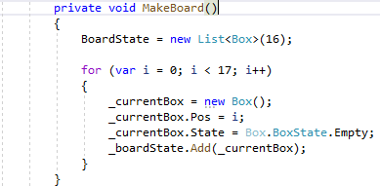
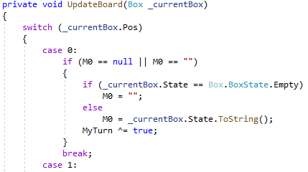
Points of Interest

Slide 4
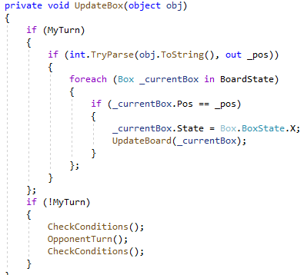
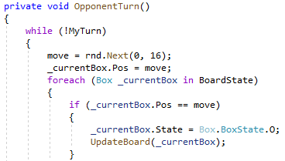
Turn Structure

Slide 5
Notes
I stole John’s relay command, delegate command, and observable object

Slide 6
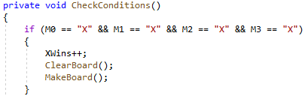
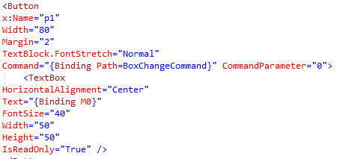
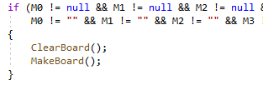
WPF Headaches

Slide 7
Conclusion
In the future…Search through saved games, highlight where game was won, and I do not want textboxes.
Takeaway: ask for help sooner, proper binding of commands (text and/or methods).

